Slide 1




Movie Recommendation

Slide 2
Introduction
In the age of digital streaming, personalized movie recommendations play a vital role in enhancing user experience. For this project, I worked with a movie dataset containing diverse attributes like genres, ratings, and user preferences. By leveraging data preprocessing, feature engineering, and advanced machine learning models, the goal was to develop a recommendation system capable of predicting and suggesting movies tailored to each user’s unique tastes. This project combines the art of understanding user behavior with the science of predictive analytics to deliver a seamless and enjoyable viewing experience.

Slide 3

Table of contents
01
02
03
04
Preprocessing
Cleaning and preparing the data, including handling missing values and adding
new features.
EDA
Analyzing and visualizing data to uncover patterns and insights.
Content-Based Recommendation
Identify and recommend movies similar to a given title based on their attributes.
Collaborative Filtering Recommendation
Analyzes ratings from similar users to provide personalized movie recommendations.

Slide 4

01
Preprocessing
Data Cleaning And Column Expansion

Slide 5
Contents Of Datasets
We Have Four CSV :
1- Movies CSV
Movie ID | A unique identifier for each movie in the dataset. It is used to differentiate between movies.
Title | The name of the movie, including additional information like the release year (e.g., The Matrix (1999)).
Genre | The categories or genres of the movie, such as Action, Comedy, Drama, etc. Some movies may belong to multiple genres, which could be listed in a delimited format.
Number of columns and rows in this csv: 87586 Row | 3 columns

Slide 6
Contents Of Datasets
We Have Four CSV :
2- Links CSV
Movie ID | A unique identifier for each movie in the dataset. It is used to differentiate between movies.
ImdbId | The unique identifier for the movie from IMDb (Internet Movie Database), allowing cross-referencing with external sources for additional metadata.
TmdbId | The unique identifier for the movie from TMDb (The Movie Database), another resource for movie information.
Number of columns and rows in this csv: 87586 Row | 3 columns

Slide 7
Contents Of Datasets
We Have Four CSV :
3- Ratings CSV
Movie ID | A unique identifier for each movie in the dataset. It is used to differentiate between movies.
User ID | A unique identifier for each user in the dataset. This helps track user-specific activities like ratings and tags.
Ratings | A numeric value representing the user’s rating for a specific movie. Ratings typically fall within a predefined scale (e.g., 1 to 5 or 0.5 to 5).
timestamp | The date and time when the user gave their rating for the movie, recorded in Unix timestamp format.
Number of columns and rows in this csv: 1048567 Row | 4 columns

Slide 8
Contents Of Datasets
We Have Four CSV :
4- Tags CSV
Movie ID | A unique identifier for each movie in the dataset. It is used to differentiate between movies.
User ID | A unique identifier for each user in the dataset. This helps track user-specific activities like ratings and tags.
Tag | A textual label or keyword that a user has associated with a movie. Tags often reflect user perceptions or themes of the movie (e.g., “inspiring,” “thrilling,” or “family-friendly”).
timestamp | The date and time when the user added the tag to a movie, also recorded in Unix timestamp format.
Number of columns and rows in this csv: 1048567 Row | 4 columns

Slide 9

Fill NULL Values
Tags CSV
(tag)
Links CSV
(tmdbId)
• Identified 124 missing values in the tmdbId column.
• Leveraged the The Movie Database (TMDb) API to retrieve missing tmdbId values using the corresponding imdbId values.
• Successfully filled the null values, ensuring a complete and consistent dataset for further analysis.
• Detected 17 missing values in the tag column.
• Since these rows were not critical for analysis, they were dropped to maintain data quality and consistency.

Slide 10
Extract More Details About Movie:
From API Request using tmdbId and imdbID
Original Language
A
B
Vote Average
Vote Count
C
D
Popularity
Columns
Runtime
E
F
Release Date
G
Poster Path

Slide 11
Extract columns
Movies CSV
(genre)
Tags & Ratings CSV
(timestamp)
• Extracted all unique genres from the genres column.
• The genres column contains multiple genres per movie, separated by a delimiter (|).
• Processed the data to create a comprehensive list of unique genres for further analysis and visualization.
• Processed the timestamp column to extract key date components:
1- Year
2- Month
3- Day
• Enabled a deeper analysis of user activity patterns and trends over time.

Slide 12
Extract columns
Calculating Weighted Vote Ratings
Incorporating Time-Based Weighting for Ratings
To account for the recency of ratings, I calculated a time-weighted rating, where more recent ratings carry greater importance. This was achieved by applying an exponential decay function based on the difference between the current timestamp and the rating timestamp.
To ensure fair evaluation of movies with varying vote counts, I calculated the weighted average rating by combining a movie’s average rating and the dataset’s overall average, weighted by the number of votes and a predefined threshold.

Slide 13
02
EDA
Analyzing and visualizing data to uncover patterns and insights.

Slide 14
Average Ratings Of User:

Slide 15
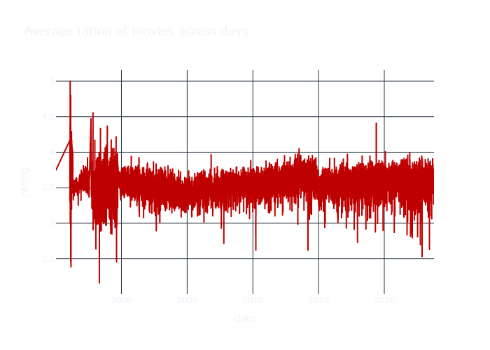
Average Ratings Of Movies Across Days:

Slide 16
Distribution of Genre Column :

Slide 17
Average Rating Of Toy Story :

Slide 18
Distribution of Language Of Movies:

Slide 19
03
Content-Based Recommendation
Identify and recommend movies similar to a given title based on their attributes.

Slide 20
Approach:
Data Processing
Model
Applied L2 normalization to the genres dataset to ensure each genre vector has a unit norm.
Utilized a K-Nearest Neighbors (KNN) algorithm to identify and recommend movies similar to a given movie based on genre similarity.

Slide 21
Pipeline:
Normalization
Ensures genre vectors are comparable by scaling them uniformly.
KNN Model
Finds the 10 nearest movies (excluding the query movie) using cosine similarity, facilitating accurate genre-based recommendations.

Slide 22
04
Collaborative Filtering Recommendation
Analyzes ratings from similar users to provide personalized movie recommendations.

Slide 23
Approach
Recommendation
Model
Prediction
Implemented Singular Value Decomposition (SVD) to analyze user ratings and predict missing ratings.
Examining the enduring legacies of the past, we find that history is not a static entity but a living force, influencing contemporary societies and institutions
Sorts predicted ratings to recommend the highest-rated movies to each user.

Slide 24
Key Metrics Explained:
RMSE
Root Mean Squared Error
MAE
Mean Absolute Error
FCP
Fraction of Concordant Pairs
Measures prediction accuracy; lower values indicate better performance.
Represents average absolute errors; lower values signify higher accuracy.
Assesses the ranking quality of predictions; higher values denote better ranking.
Fit Time
Test Time
Time taken to train the model.
Time required to make predictions on the test set.

Slide 25
Cross-Validation:
Metric | Fold 1 | Fold 2 | Fold 3 | Fold 4 | Fold 5 | Mean | Std
RMSE | 0.7718 | 0.7716 | 0.7719 | 0.7718 | 0.7717 | 0.7718 | 0.0001
MAE | 0.5802 | 0.5798 | 0.5801 | 0.5800 | 0.5799 | 0.5800 | 0.0001
FCP | 0.7431 | 0.7424 | 0.7431 | 0.7424 | 0.7430 | 0.7428 | 0.0003
Fit Time (s) | 333.03 | 467.80 | 456.58 | 461.28 | 415.59 | 426.86 | 50.35
Fit Time (s) | 1143.84 | 1068.18 | 1858.65 | 1134.59 | 1780.47 | 1397.15 | 346.77

Slide 26

Thanks!
Do you have any questions?
By : Mahmoud Bahar

